Slide 1
Unit-1
Introduction to Computer Networks

Slide 2
Data Flow
Communication between two devices can be simplex, half-duplex, or full-duplex .
Simplex: In simplex mode, the communication is unidirectional, as on a one-way street. Only one of the two devices on a link can transmit; the other can only receive. Keyboards and traditional monitors are examples of simplex devices.
The keyboard can only introduce input; the monitor can only accept output.
The simplex mode can use the entire capacity of the channel to send data in one direction.

Slide 3
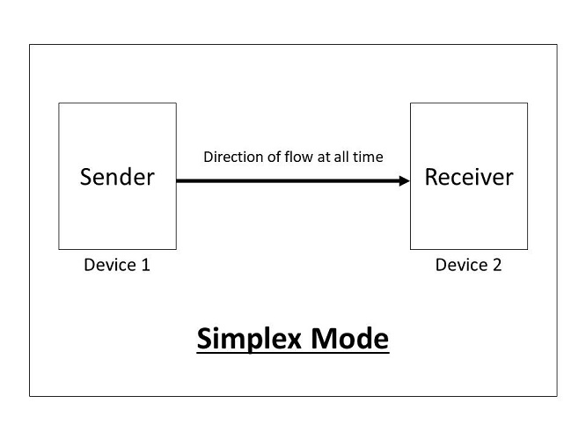

Slide 4
Half-Duplex: In half duplex mode, each station can both transmit and receive, but not at the same time. When one device is sending, the other can only receive, and vice versa.
The half-duplex mode is like a one-lane road with traffic allowed in both directions.
The half-duplex mode is used in cases where there is no need for communication in both directions at the same time; the entire capacity of the channel can be utilized for each direction.

Slide 5
Half Duplex

Slide 6
Full-Duplex: In full-duplex mode(also called duplex), both stations can transmit and receive simultaneously.
The full-duplex mode is like at two- way street with traffic flowing in both directions at the same time.
One common example of full-duplex communication is the telephone network. When two people are communicating by a telephone line, both can talk and listen at the same time.

Slide 7
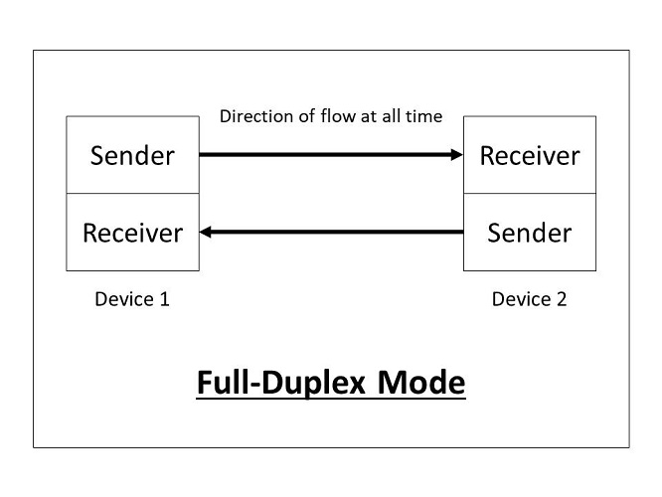

Slide 8
A network is a set of devices (often referred to as nodes) connected by communication links. A node can be a computer, printer, or any other device capable of sending and/or Receiving data generated by other nodes on the network.
Network Criteria:
Performance: Performance can be measured in many ways, including transit time and response time. Transit time is the amount of time required for a message to travel from one device to another. Response time is the time spent between an inquiry and a response.

Slide 9
Reliability: Reliability is concerned with the ability of a network to carry Reliability is concerned with the ability of a network to carry out a desired operation such as "communication". It is measured by the frequency of failure.
Security: Network security issues include protecting data from unauthorized access, protecting data from damage and development, and implementing policies and procedures for recovery from breaches and data losses.

Slide 10
Type of Connection
For communication to occur, two devices must be connected in some way to the same link at the same time. There are two possible types of connections: point-to-point and multipoint.
Point-to-Point: A point-to-point connection provides a dedicated link between two devices. The entire capacity of the link is reserved for transmission between those two devices.

Slide 11
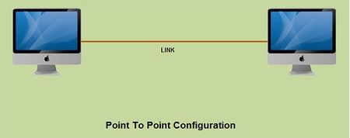

Slide 12
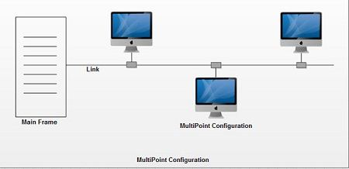
Multipoint/ Multidrop: A multipoint connection is one in which more than two specific devices share a single link.

Slide 13
n(n-1)/2
A
B
D
C

